Slide 1
Lent Week 6 Presentation

Slide 2
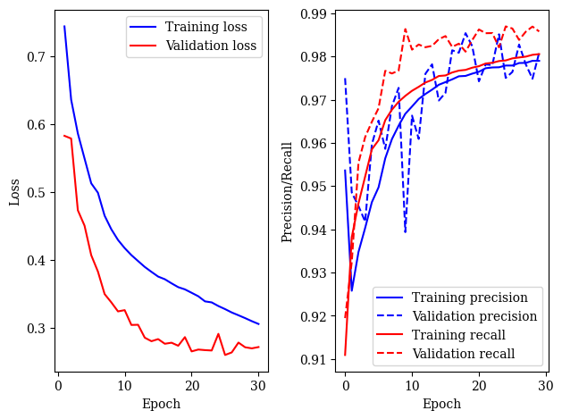
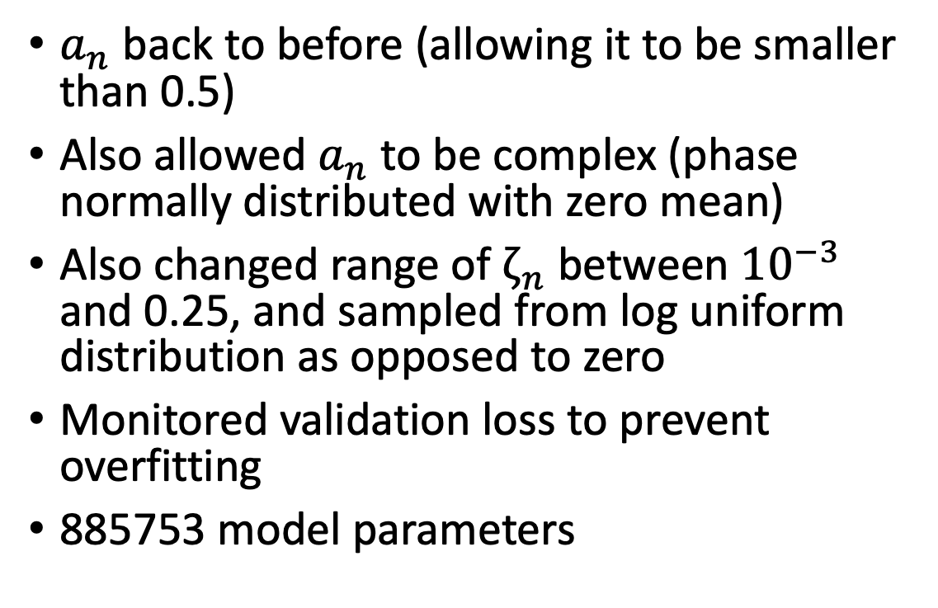
New Model
$a_{n}$ back to before (allowing it to be smaller than 0.5)
Also allowed $a_{n}$ to be complex (phase normally distributed with zero mean)
Also changed range of $ζ_{n}$ between ${10}^{−3}$ and 0.25, and sampled from log uniform distribution as opposed to zero
Monitored validation loss to prevent overfitting
885753 model parameters

Slide 3
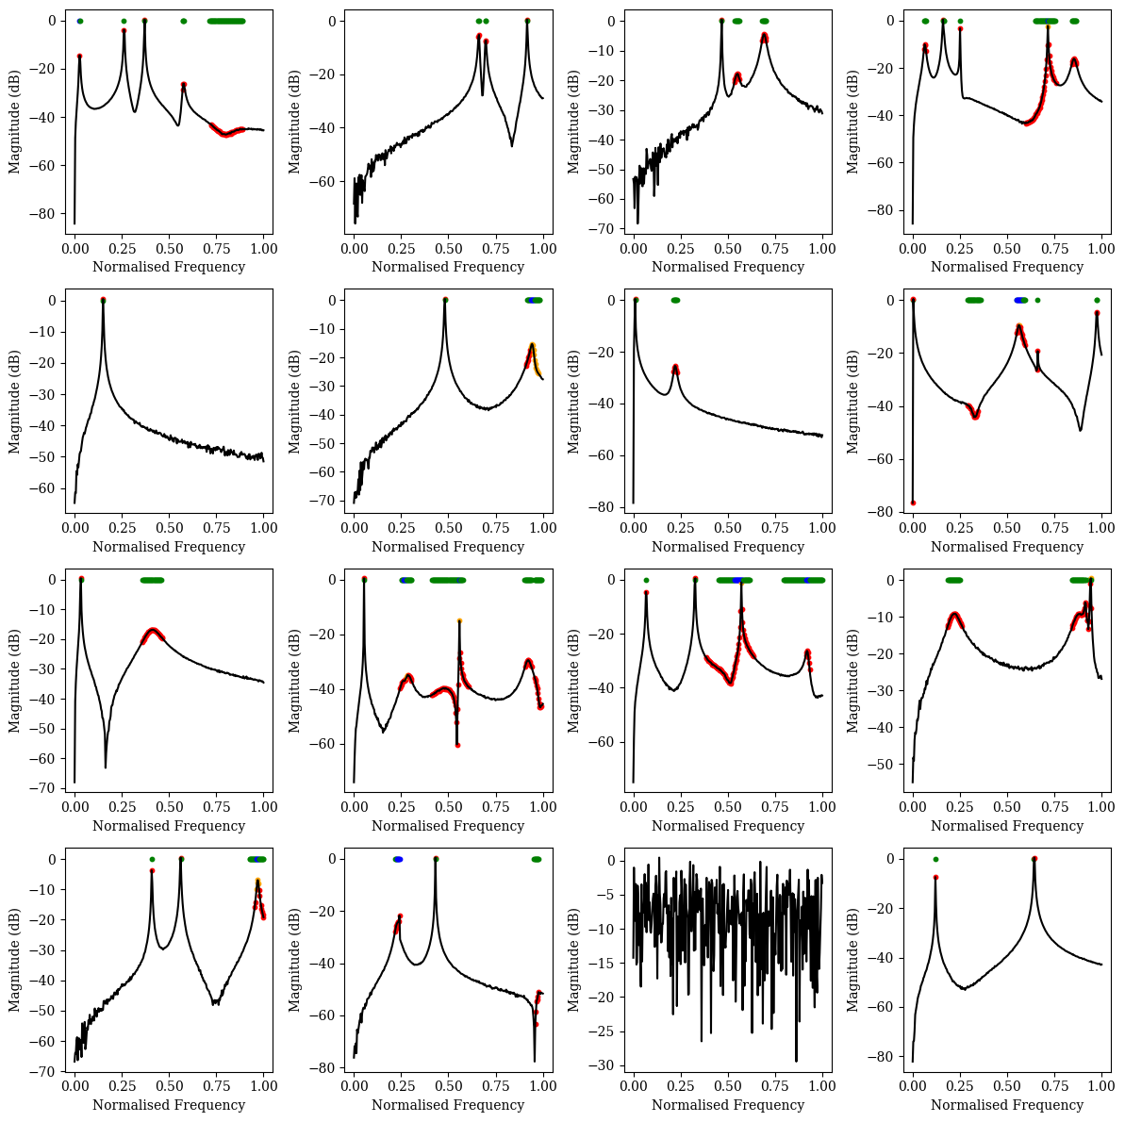
Transfer functions now look more spiky

Slide 4
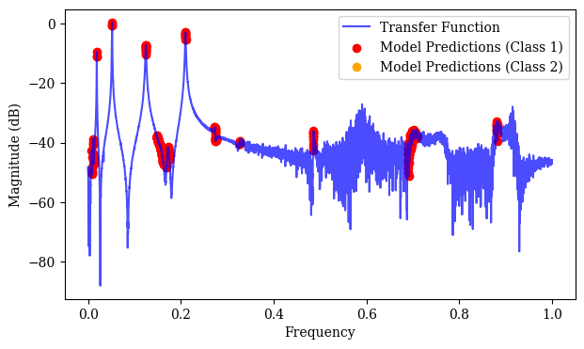
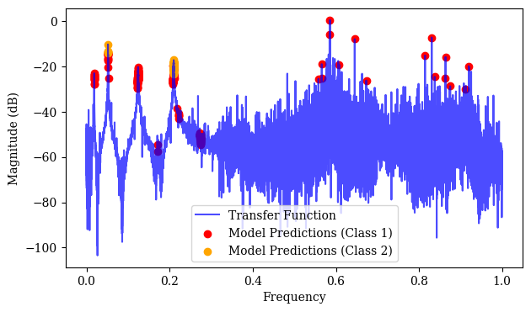
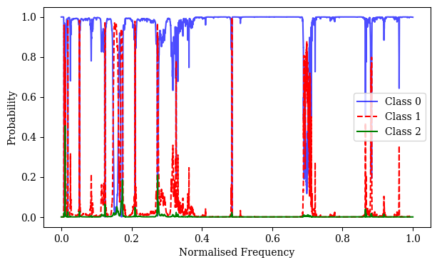
3C6 Data
Works well on non-noisy TF, but starts picking up points in the noise.

Slide 5
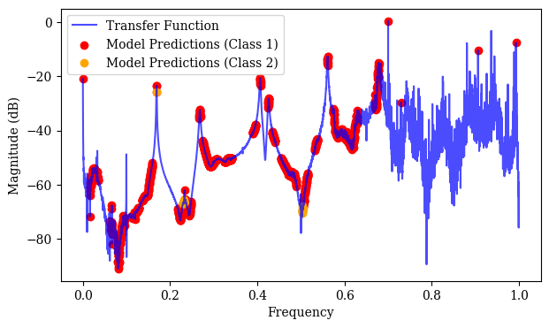
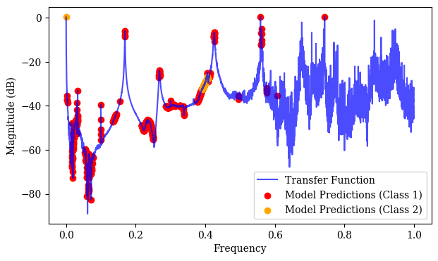
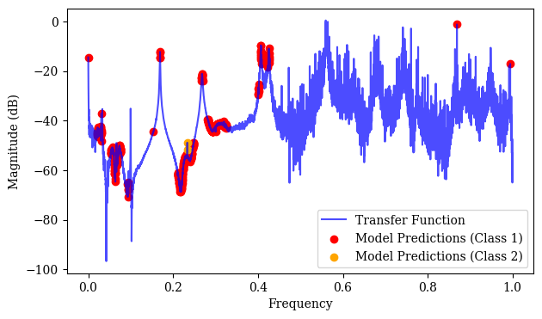
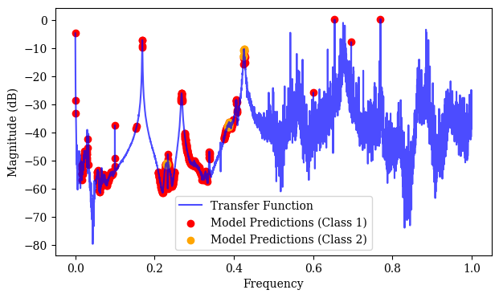
4C6

Slide 6
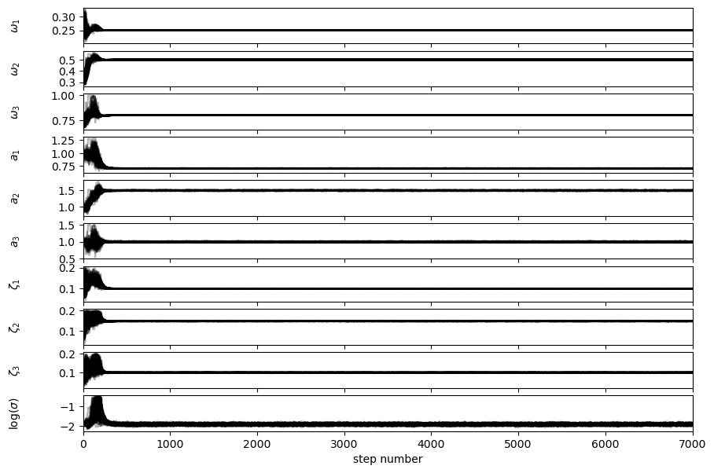
Sampling
Changed likelihood function to incorporate addition of noise separately to real and imaginary parts
All variable samples now converge, noise variance is underestimated but working better. 200 walkers, 7000 samples (unnecessary):

Slide 7
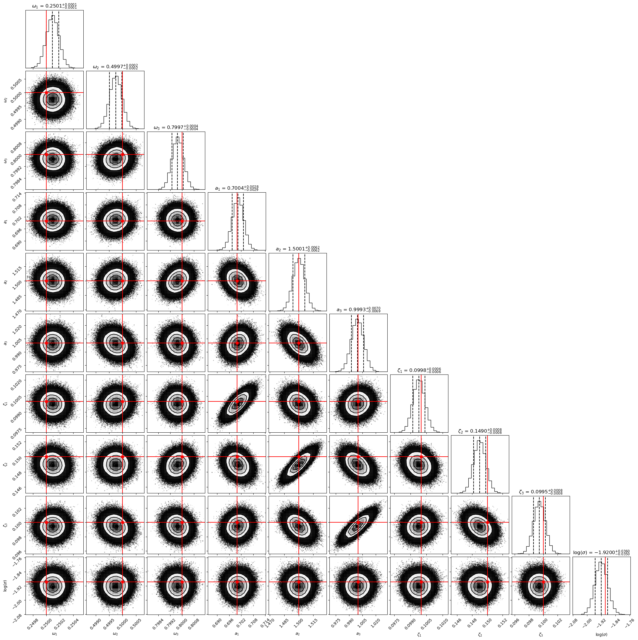
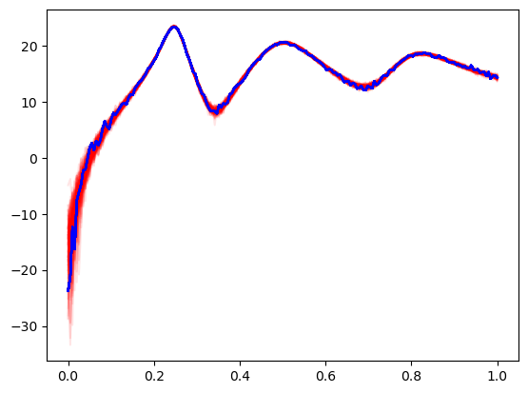
100 samples from the posterior

Slide 8
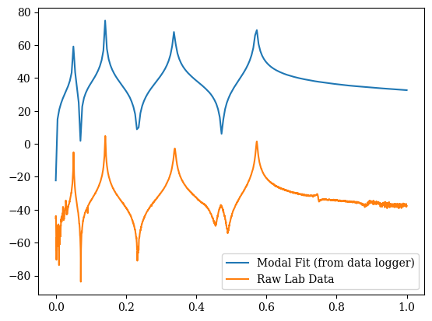
Scaling Issue ?
Not sure what this is being caused by

Slide 9
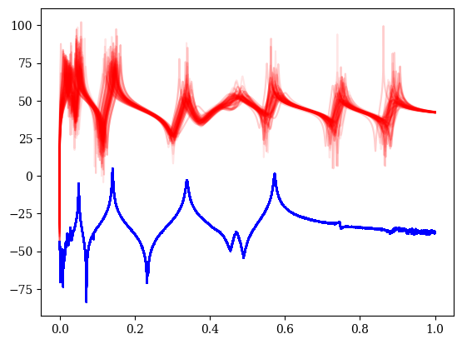
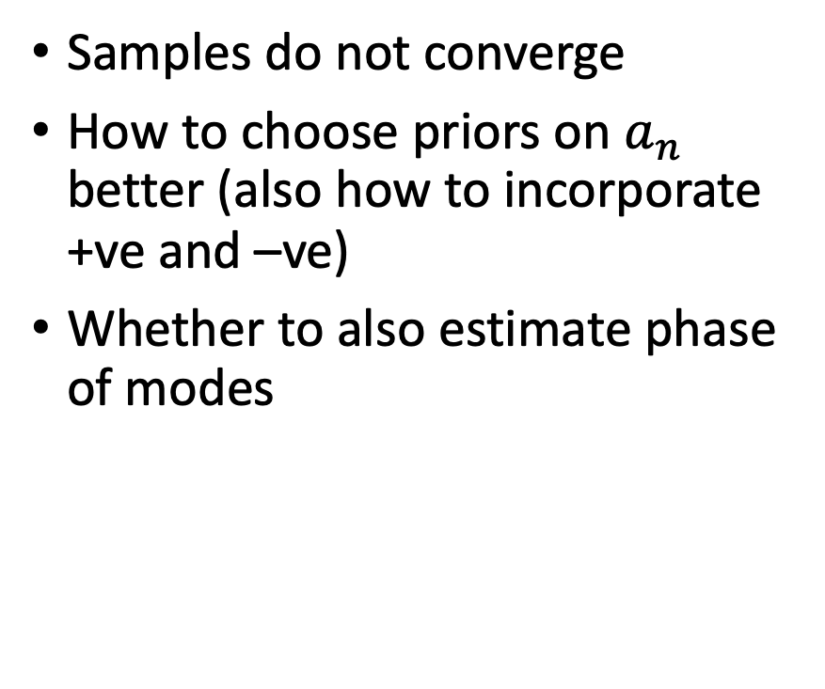
Issues with priors, and scaling
Samples do not converge
How to choose priors on $a_{n}$ better (also how to incorporate +ve and –ve)
Whether to also estimate phase of modes

